Slide 1


Design and Innovation Project
Learn a new language through competition.
Presented by: Group 7

Slide 2
Relevance of Language Learning
1.5 Billion people learning new language globally
USD 52 Billion global language learning market size value
CAGR of 20% between 2023 and 2032 Estimate Market Value in 2032: USD 337.2 Billion

Slide 3
Relevance of Language Learning
12%
79% prefers online learning
6.6%
Global Language Learning Market (2023) [2]
Online Language Learning (2023) [2]
Online Learning vs Classroom Teaching [2]

Slide 4
Relevance of Gamification
Increases Motivation, Engagement, Participation, Loyalty and Behaviour
More Fun, Interactive and Rewarding
Provides Feedback and Challenges
Levels, Time Limits provide learners with Immediate Progress
Show Challenges that matches the Learner’s Increasing Performance
Stimulates Curiosity and Interest
Supports Different Learning Styles and Needs
Adapted to Different Learners Personality, Goals and Preferences
Collaboration, Competition to Promote Social Interaction
Enhances Language Skills and Outcomes
Improve Language Proficiency in Vocabulary, Grammar and Pronunciation
Connect Language to Real World

Slide 5

Design

Slide 6
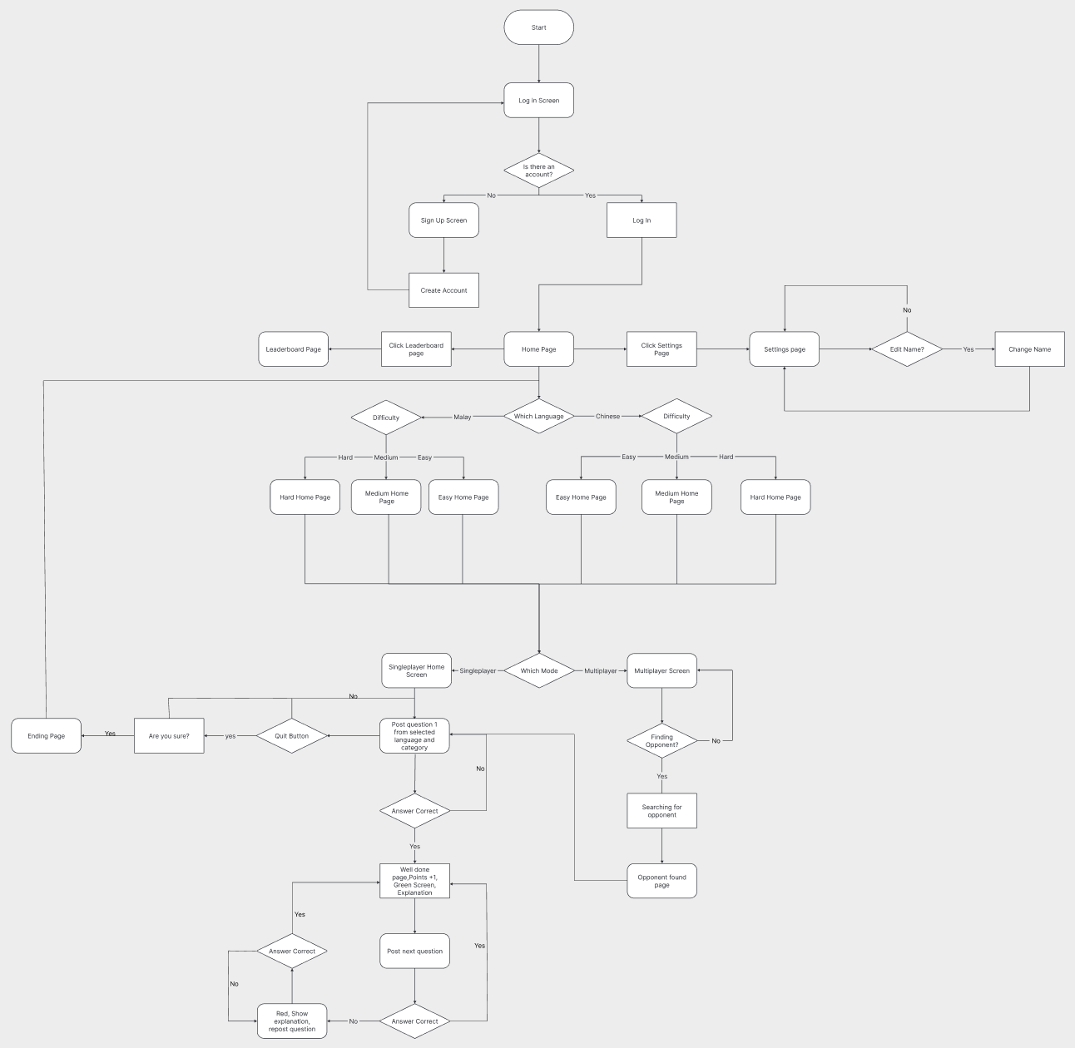
User Flow Diagram

Slide 7
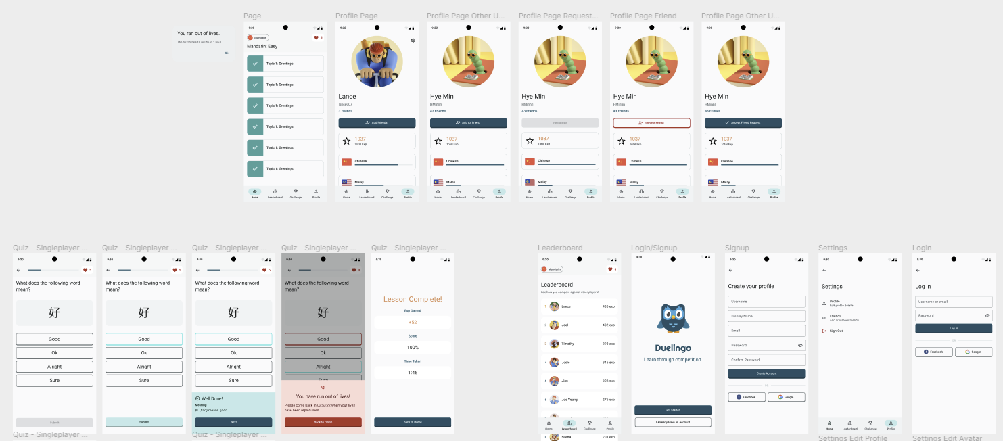
UI Screens

Slide 8


Tech We Used
Front End
Back End

Slide 9
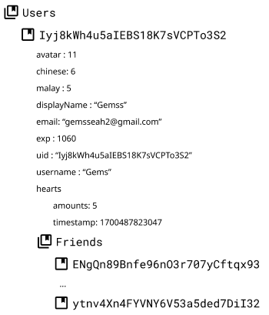
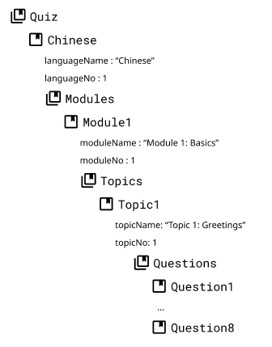


Firebase
Users
Questions
Legend:
Collection
Document

Slide 10
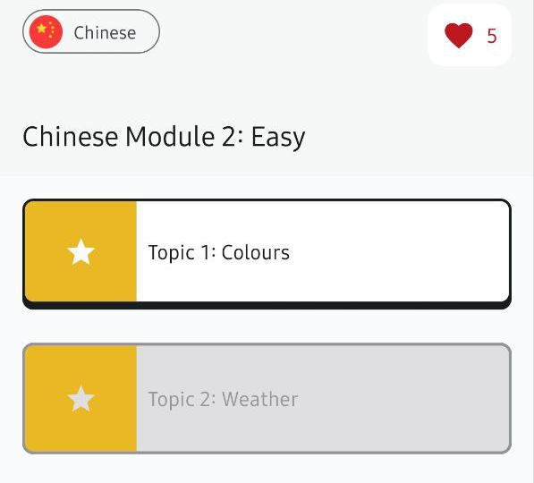
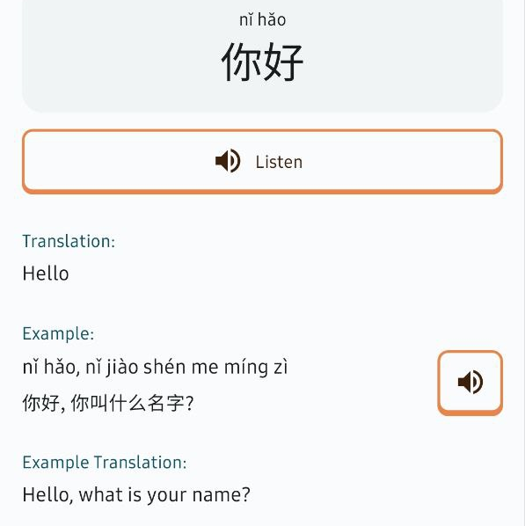
Main Features of DUELingo
Storyline
Interactive Storyline, With:
Vocabulary
Pronunciation-Aid
Examples of How to use in a sentence
End of Each Module:
Tutorial-style Questions
Immediate Feedback

Slide 11
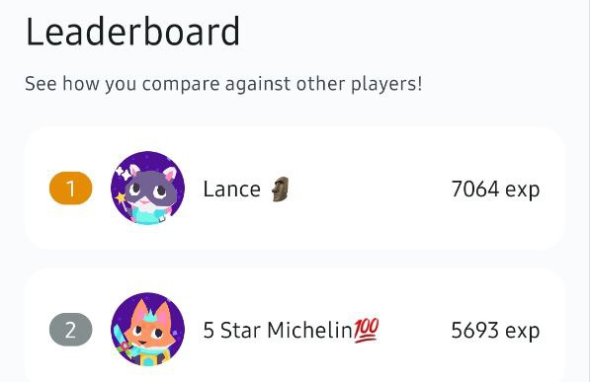
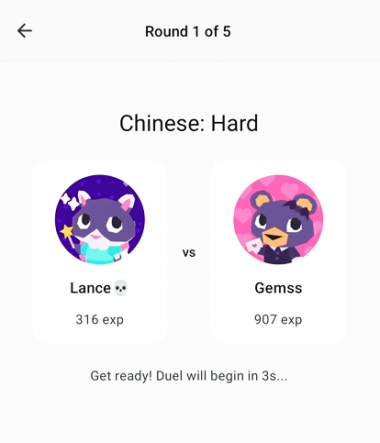
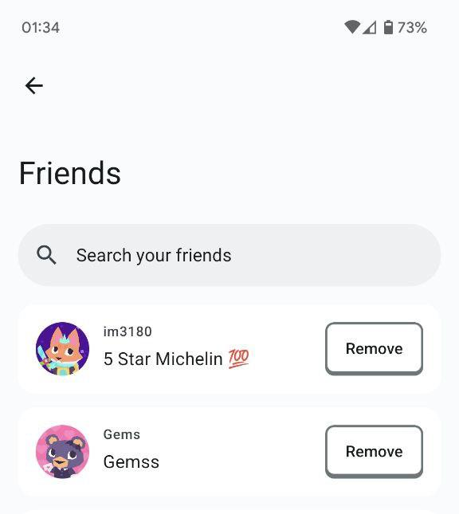
Main Features of DUELingo
Multiplayer
Connect And Compete With Friends Learning The Same Language As You!
Play with Friends
Benefits:
Friendly Competition, User- Engagement
Additional Learning Opportunities
Goal-Oriented Learning

Slide 12

Video

Slide 13
App Demonstration

Slide 14
References

